Slide 1
Software Requirements Engineering
By
Abid Ali
BS Software Engineering
5th
Lecture #2

Slide 2
Agenda
Every project has requirements
When bad requirements happen to good people
-Insufficient user involvement . . . . . . . .
-Inaccurate planning . . . . . . . . . . . . . . . .
-Creeping user requirements . . . . . . . . . .
-Ambiguous requirements . . . . . . . . . . .
-Gold plating . . . . . . . . . . . . . . . . . . . . . .
-Overlooked stakeholders . . . . . . . . . . . .
Benefits from a high-quality requirements process

Slide 3
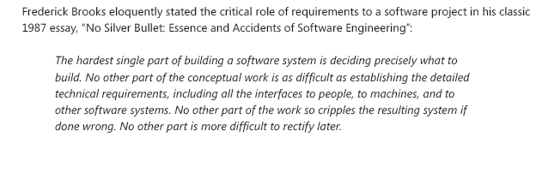
Every project has requirements

Slide 4
Cont..
Every software-containing system has stakeholders who rely on it.
The time spent understanding their needs is a high-leverage investment in project success.
If a project team does not have written representations of requirements that the stakeholders agree to, how can developers be sure to satisfy those stakeholders?

Slide 5
When bad requirements happen to good people
The major consequence of requirements problems is rework—doing again something that you thought was already done—late in development or after release.
Rework often consumes 30 to 50 percent of your total development cost (Shull, et al. 2002; GAO 2004), and requirements errors can account for 70 to 85 percent of the rework cost (Leffingwell 1997).
Some rework does add value and improves the product, but excessive rework is wasteful and frustrating.

Slide 6
Most Common Requirements Risks
Insufficient user involvement:
Customers often don’t understand why it is so essential to work hard on eliciting requirements and assuring their quality.
Developers might not emphasize user involvement, perhaps because they think they already understand what the users need.

Slide 7
Cont..
Inaccurate planning:
Vague, poorly understood requirements lead to overly optimistic estimates, which come back to disturb you when the inevitable overruns occur.
The top contributors to poor software cost estimation are frequent requirements changes, missing requirements, insufficient communication with users, poor specification of requirements, and insufficient requirements analysis (Davis 1995 ).

Slide 8
Cont..
Creeping user requirements:
As requirements evolve during development, projects often exceed their planned schedules and budgets.
To manage scope creep, begin with a clear statement of the project’s business objectives, strategic vision, scope, limitations, and success criteria.
Evaluate all proposed new features or requirements changes against this reference.

Slide 9
Cont..
Ambiguous requirements
One symptom of ambiguity in requirements is that a reader can interpret a requirement statement in several ways (Lawrence 1996).
Another sign is that multiple readers of a requirement arrive at different understandings of what it means.
Collaborative elicitation and validation encourages stakeholders to discuss and clarify requirements as a group in a workshop setting.
Writing tests against the requirements and building prototypes are other ways to discover ambiguities.

Slide 10
Cont..
Gold plating
Gold plating takes place when a developer adds functionality that wasn’t in the requirements specification (or was deemed out of scope) but which the developer believes “the users are just going to love.”
If users don’t care about this functionality, the time spent implementing it is wasted

Slide 11
Cont..
Overlooked stakeholders
Most products have several groups of users who might use different subsets of features, have different frequencies of use, or have varying levels of experience.
If you don’t identify the important user classes for your product early on, some user needs won’t be met

Slide 12
Benefits from a high-quality requirements process
The potential payoff includes:
Fewer defects in requirements and in the delivered product.
Reduced development rework.
Faster development and delivery.
Fewer unnecessary and unused features.
Lower enhancement costs.
Fewer miscommunications.
Reduced scope creep.
Reduced project chaos.
Higher customer and team member satisfaction.
Products that do what they’re supposed to do.

Slide 13
The end
Thank you

